Slide 1

Navigating the Future: The Game-Changing Role of AI Recruiting Agents on LinkedIn
Lakshmanan
06-Nov-2024

Slide 2
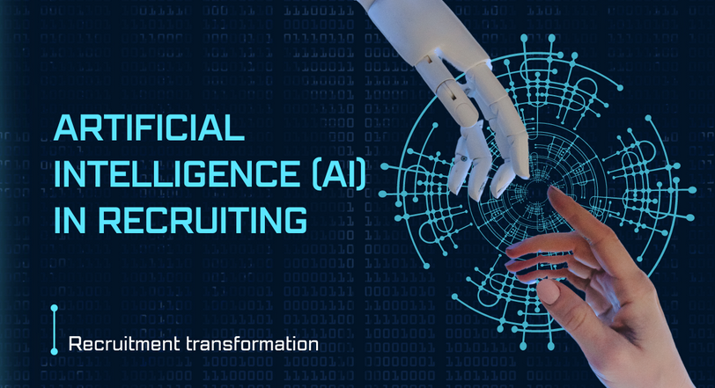
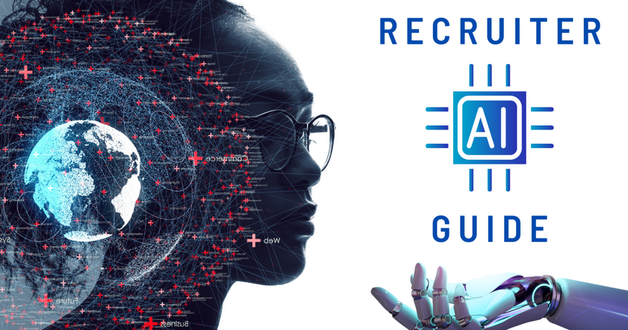
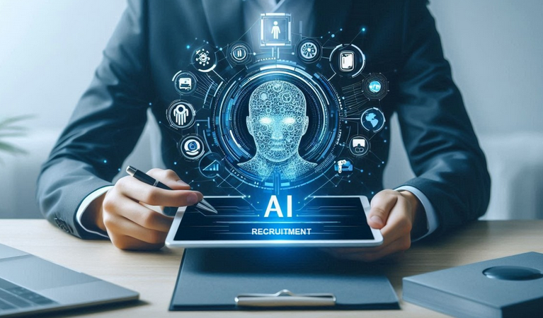
Exploring the Landscape of AI in Recruitment:
Overview of AI Recruiting:
AI recruiting agents leverage advanced algorithms to transform traditional hiring methods, offering a new paradigm for talent acquisition.
An AI recruiting agent is a software tool that utilizes machine learning to automate various stages of hiring, enhancing decision-making processes.
Importance of AI in Recruiting:
Harnessing AI can streamline recruitment processes, reduce bias, and create a more data-driven hiring experience.
Evolution of Recruiting Technologies:
The evolution of AI in recruitment has transitioned from keyword matching to sophisticated systems that can analyze context and candidate behavior.
Understanding the Technological Underpinnings:
Artificial Intelligence encompasses a range of technologies enabling machines to simulate human intelligence in decision-making and problem-solving.
Machine Learning allows systems to learn from data and improve their performance over time, vital for optimizing candidate selection algorithms.
Natural Language Processing in Recruiting,
Natural Language Processing (NLP) enables AI to understand and interpret human language, crucial for analyzing resumes and extracting insights.

Slide 3
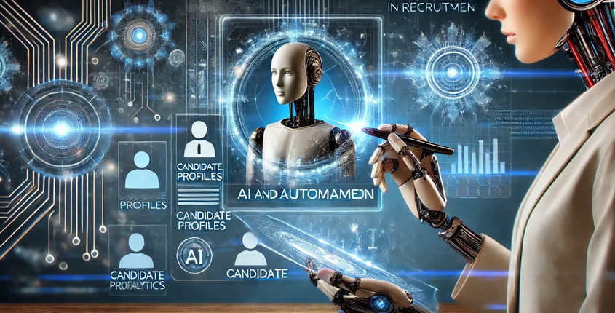
AI Recruiting Agent: Features & Capabilities:
Profile Matching:
AI algorithms can analyze vast amounts of data to identify the best-fit candidates based on qualifications and predicted job performance.
Automated Screening:
Automation allows for rapid sifting through resumes, enabling recruiters to focus on the most promising candidates without manual effort.
Candidate Engagement:
AI recruiting agents facilitate ongoing communication with candidates, providing timely updates and enhancing the applicant experience.
Interview Scheduling Automation:
Support in scheduling interviews through integrated calendars streamlines the process, reducing the administrative burden on recruiters.
Integration with LinkedIn:
Utilizing LinkedIn API
AI recruiting agents integrate with the LinkedIn API to access vast data pools, enhancing the ability to match candidates with job openings.
Linking with various data sources allows for a more comprehensive view of a candidate's skills, experiences, and professional network.
Enhancing User Experience
By leveraging LinkedIn's rich data, AI recruiting agents can create more personalized and relevant job recommendations for users.
Synergy with Existing Tools
AI recruiting agents can complement existing LinkedIn features, creating a seamless user experience within the recruitment ecosystem.

Slide 4
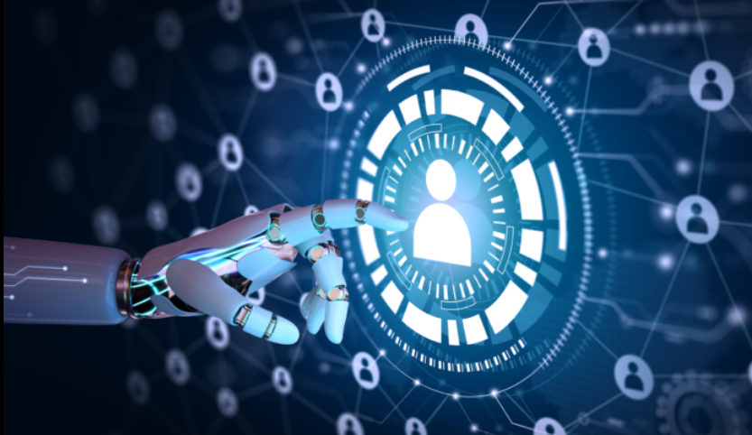
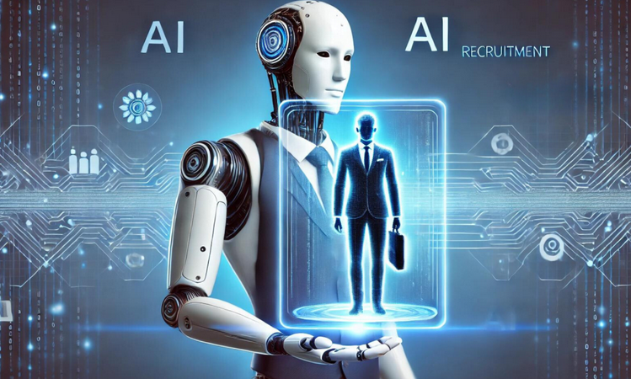
User Perspectives: Recruiters and Candidates:
Recruiter Experience:
Recruiters benefit from reduced workloads and enhanced decision-making capabilities through AI tools that provide actionable insights.
Candidate Experience:
Candidates experience streamlined application processes and proactive communication, contributing to satisfaction and engagement.
Effective Communication Strategies:
AI tools facilitate consistent messaging and timely updates, bridging gaps in communication between recruiters and candidates.
Acceptance Levels:
The level of acceptance for AI-recruiting tools varies by demographics, impact of user experience, and perceived value of AI in recruitment.
Future Trends in AI Recruiting:
Technological Advancements: AI is evolving rapidly, with continuous advancements in algorithms and machine learning paving the way for more intelligent recruiting solutions.
The rapidly changing job market will influence recruitment strategies,
Skills-Based Recruitment Focus: The future of recruiting will prioritize skills and competencies over traditional credentials, reshaping hiring paradigms.
Personalized Recruitment Approaches: Adopting tailored approaches that meet candidate preferences and career aspirations will become essential for attracting top talent.

Slide 5


Benefits of AI Recruiting Agents:
Maximizing Efficiency and Improving Experiences
Time Efficiency
Cost Reduction
Enhanced Candidate Experience
Bias Reduction
Challenges and Limitations:
Navigating the Complex Landscape of AI in Recruiting
Data Privacy Concerns
Algorithmic Bias Risks
Dependence on Technology
Resistance to Change
Terraforming Mars:
Musk has proposed terraforming Mars to make it more Earth-like. This involves altering the planet's atmosphere and temperature, a long-term goal that could take centuries.

Slide 6


